Slide 1
GREEN BUILDING
A NECESSARY STEP

Slide 2
Lorne Mlotek
TOUR GUIDE
ANCIENTBUILDINGS EXHIBITING SUSTAINABLE PRACTICES
Note this was our technology x years ago.
This is us now, inefficiently, unethically and shortsited
use of all our resources.

Slide 3
Lorne Mlotek
TOUR GUIDE
ANCIENTBUILDINGS EXHIBITING SUSTAINABLE PRACTICES
Note this was our technology x years ago.
This is us now, inefficiently, unethically and shortsited
use of all our resources.

Slide 4
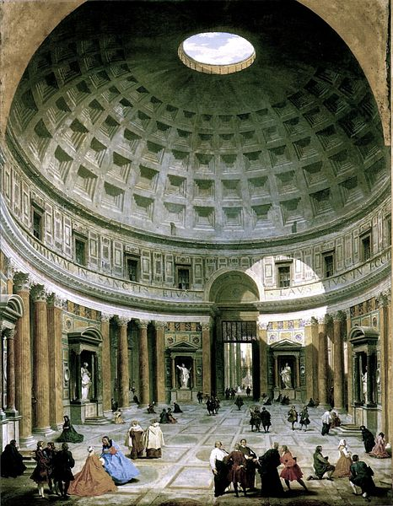
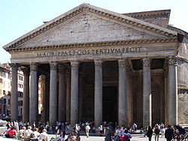
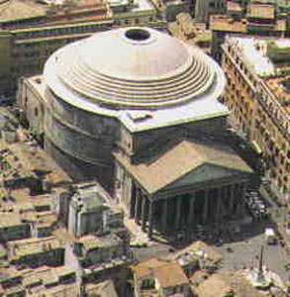
27 BC
Global Population: 150 Mil.

Slide 5
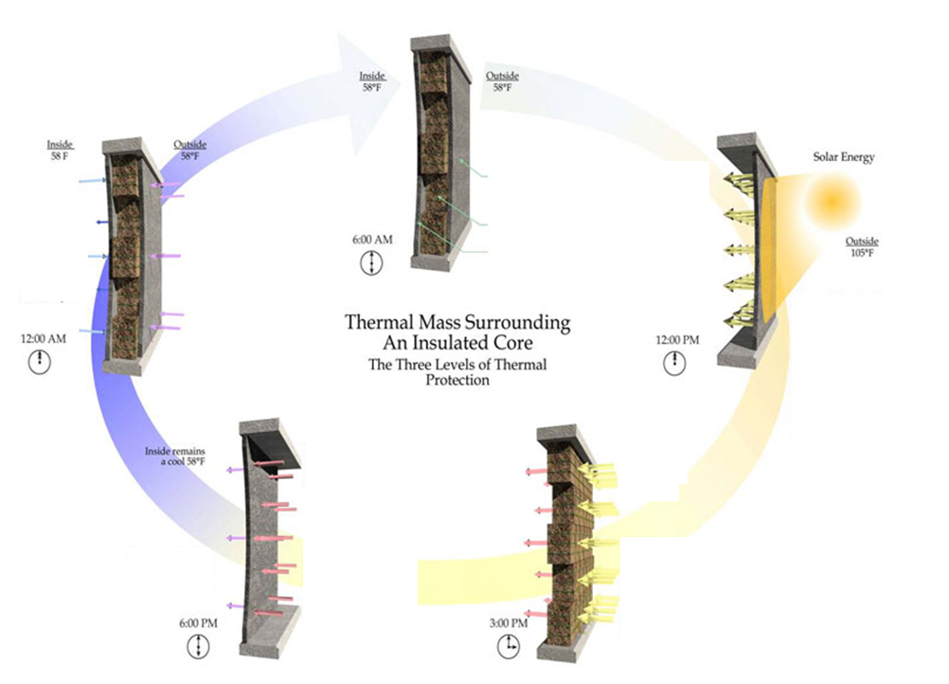

Slide 6
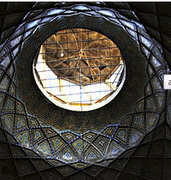
100 AD

Slide 7
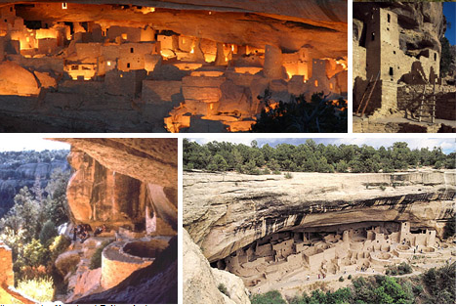
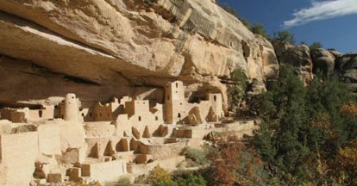
Year Unknown

Slide 8
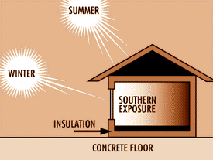
PASSIVE SOLAR

Slide 10
12th Century BC

Slide 11
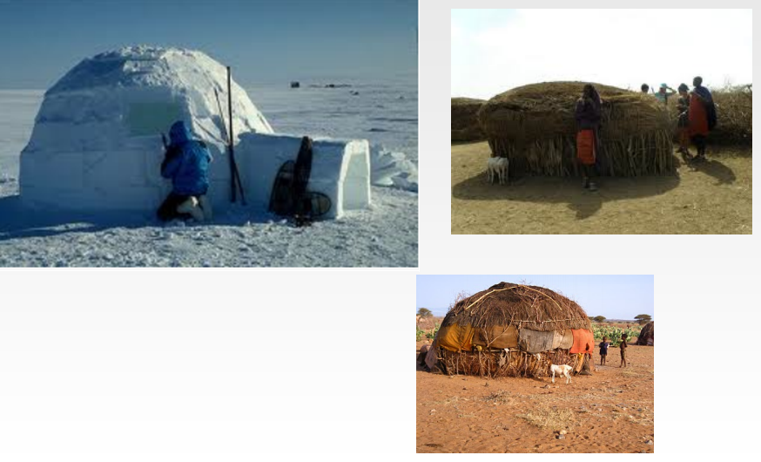
Notes:
Can we build with the earth instead of fighting mother nature? They did. Mud, Ice, and branches

Slide 12
BACK IN PRESENT

Slide 13
Earth’s Perspective
Some History
The Industrial Revolution
Carbon – The Problem
Climate Change – The Result
The Destructive Effects
You and the Earth
Notes:
Overview and lots set the context of the issue at hand

Slide 14
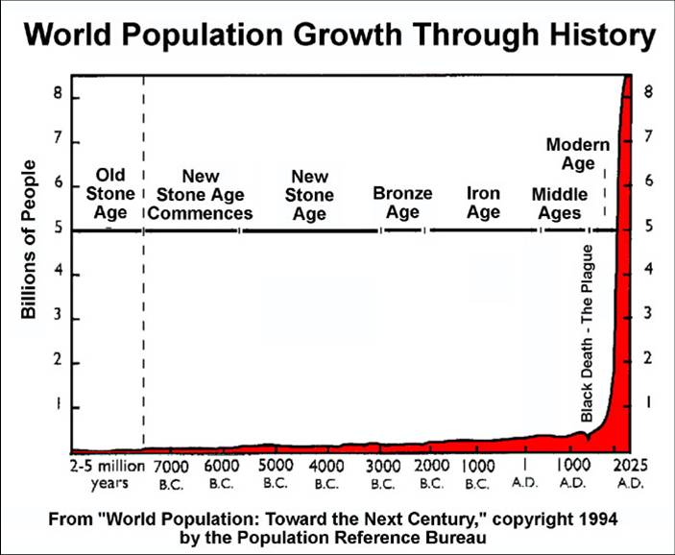
AGENDA
7+ Billion Humans
NEED ENERGY
Background on a credit category, continuing into why it should be altered and then finally WHAT is available
WHAT WE SHOULD DO

Slide 15
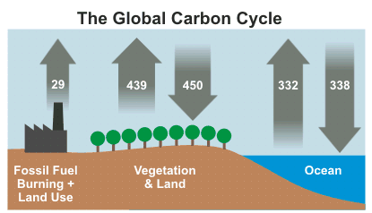
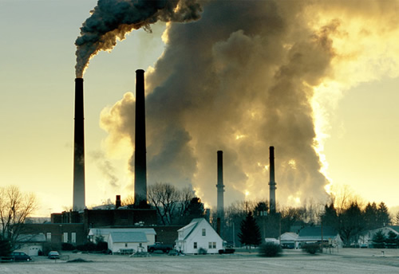
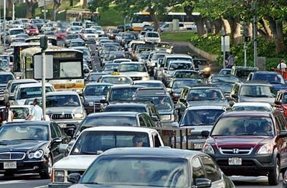
40% of excess is absorbed₁
COAL POWER
98g of CO₂ per 10^6 J of energy₂
# IN GIGATONS
67g of CO₂ per 10^6 J of energy₂

Slide 16
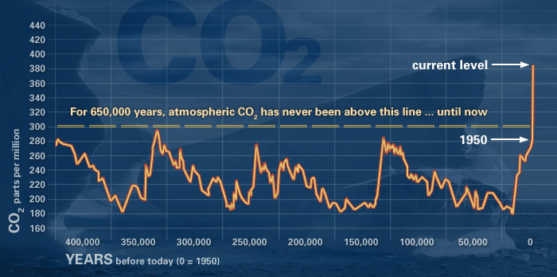
History
[3]

Slide 17
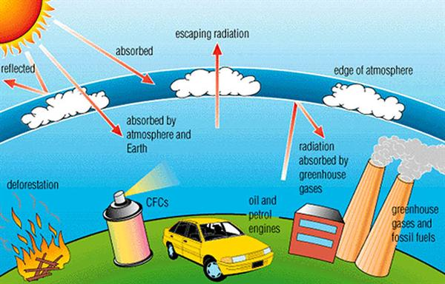
Green House Effect
Green House Gases are another warming mechanism
Earth has increased 1.1°F since the 20th century
[2]
[3]
Notes:
Can i see this?

Slide 18
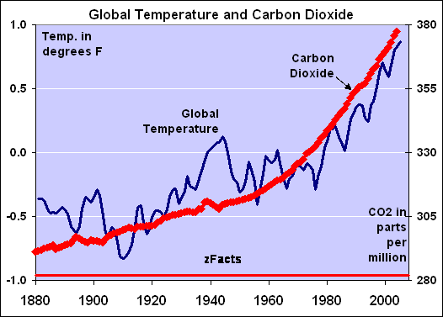
This degree of change has never been recorded in history₃

Slide 19
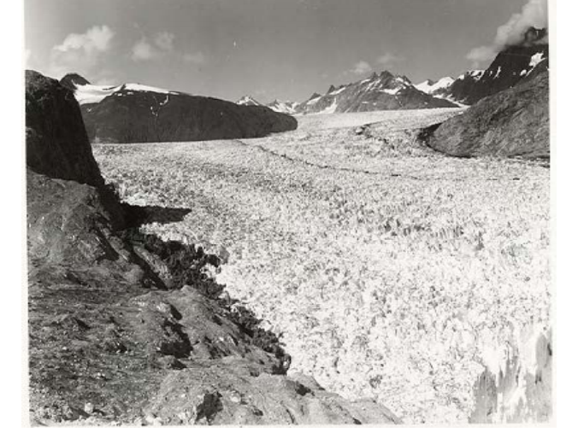
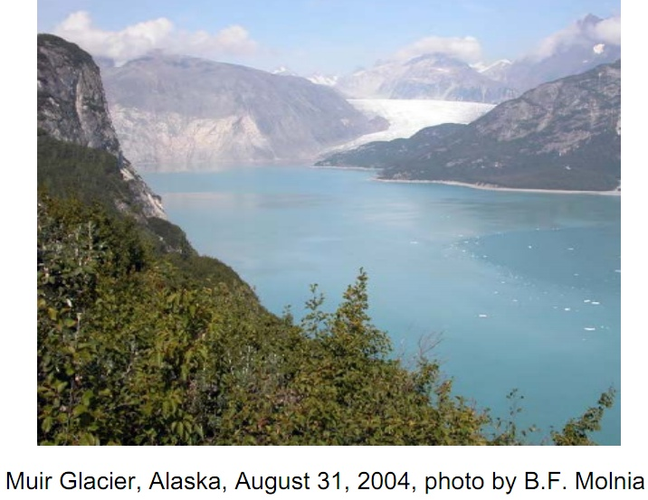
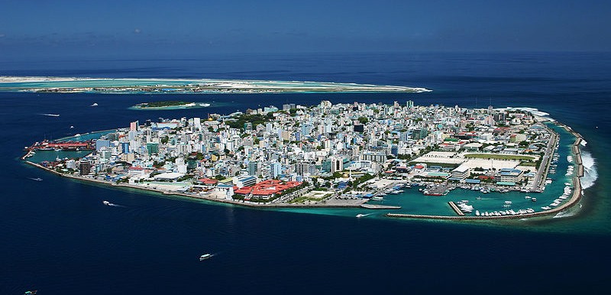
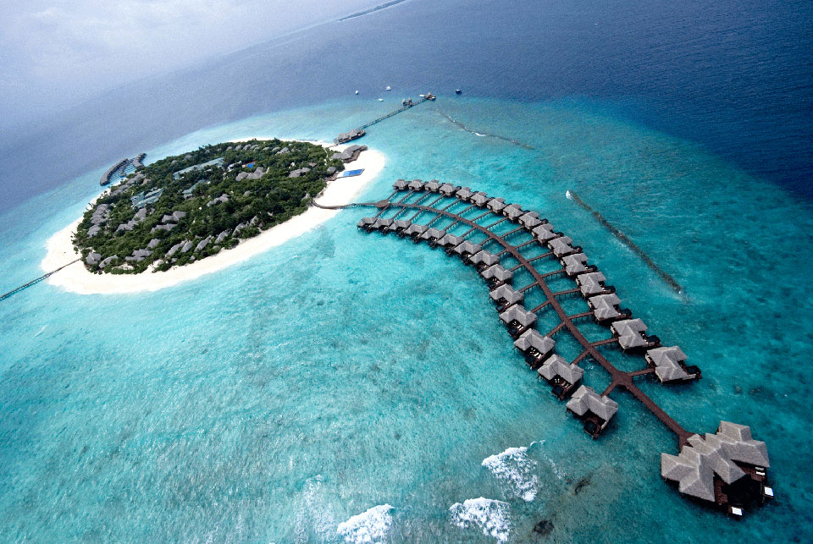
August
1941
August
2011
7
Oceans levels have risen more than 17cm
4
Maldives

Slide 20
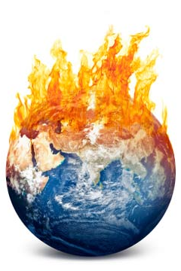
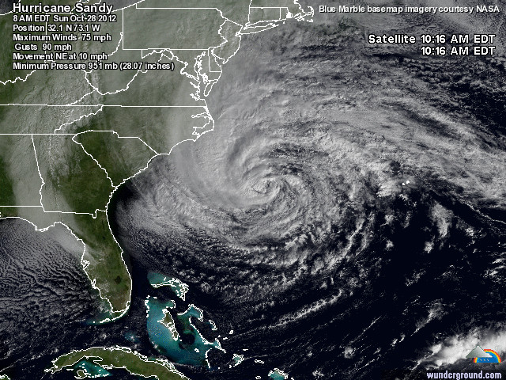
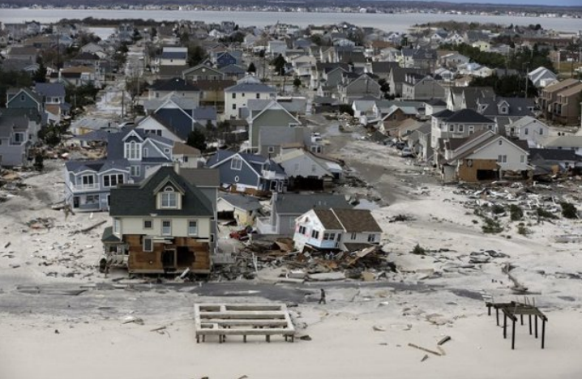
0.5°F Warmer Waters over 100 years₅
Category 5 Storms have Doubled in the past 30 years ₅
HURRICANE SANDY: 2012 ₆

Slide 21
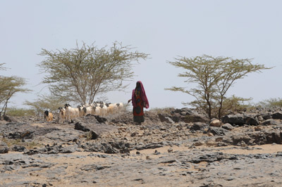
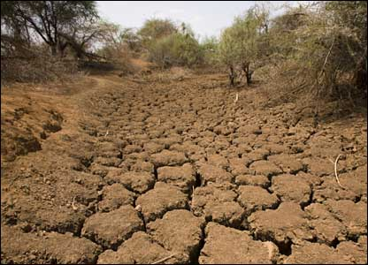
DRAUGHT
30% of agricultural land surface is at risk
Within 100 years from today
Due to warming temperature and waters
250 milllion Africans will suffer
[Hadley Centre for Climate Prediction and Research. _{10]}
[10]

Slide 22
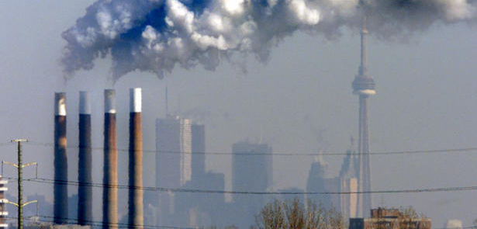
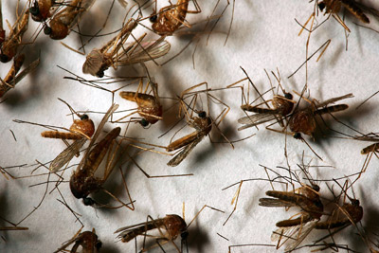
Health Impacts
Directly linked to Respiratory Illness – BEIJING!_{[11]}
Warmer Temperatures ➔ Better breeding for mosquitoes ➔ Disease carried easier and further _{[11]}

Slide 23
AGENDA
Finite amount of resources
Generous enough to share them
Unevenly dispersed
No sense in wasting
Un-Economic
Inefficient
Short sighted
Consumption Rate
Background on a credit category, continuing into why it should be altered and then finally WHAT is available
WHAT WE SHOULD DO

Slide 24
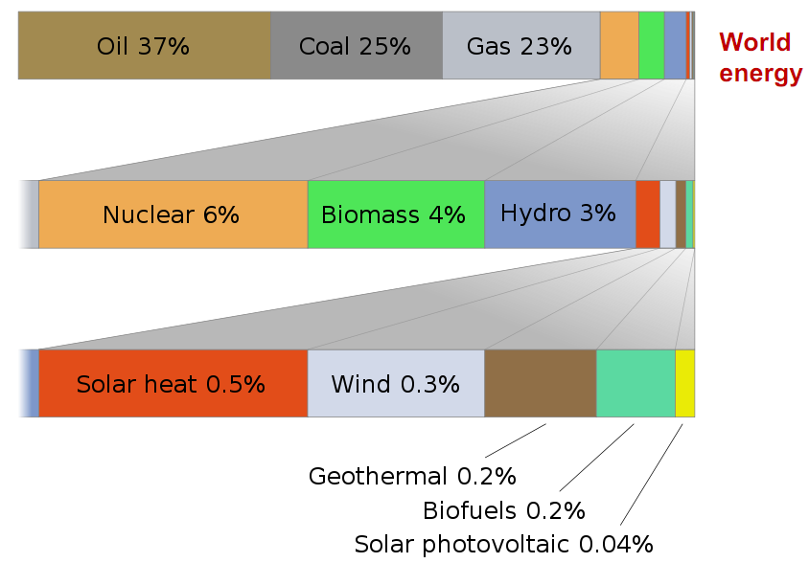
[12]

Slide 25
[12]

Slide 26
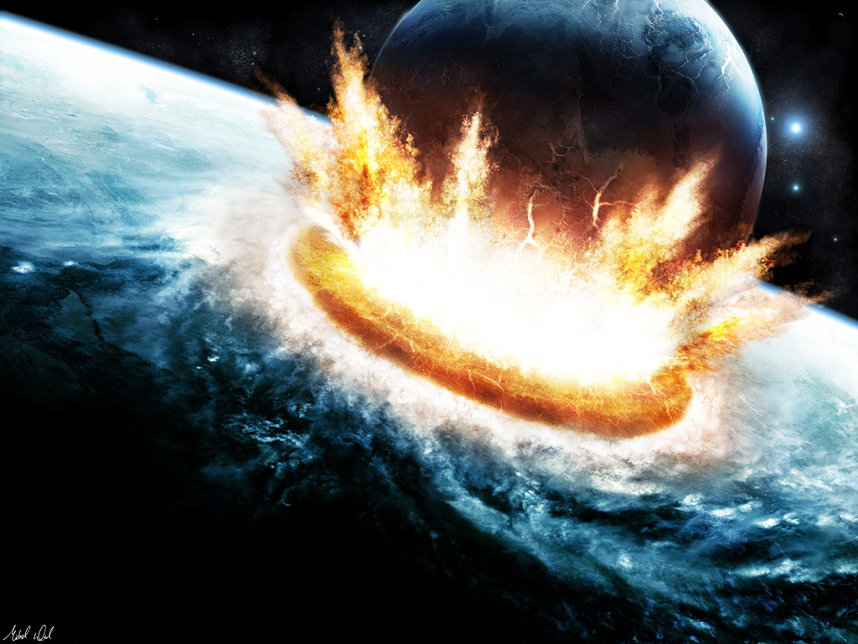
Asteroid hitting earth

Slide 28
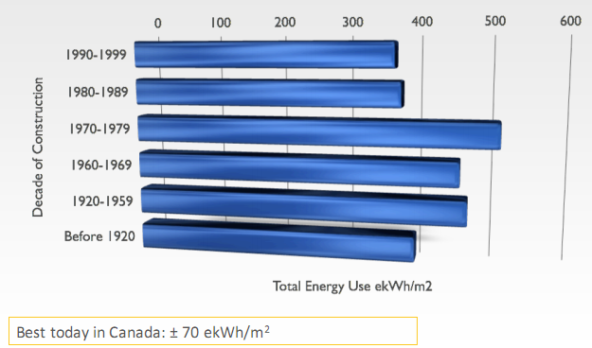
A Brief History Lesson
Notes:
Equivalent KWh

Slide 29
A Brief History Lesson

Slide 30
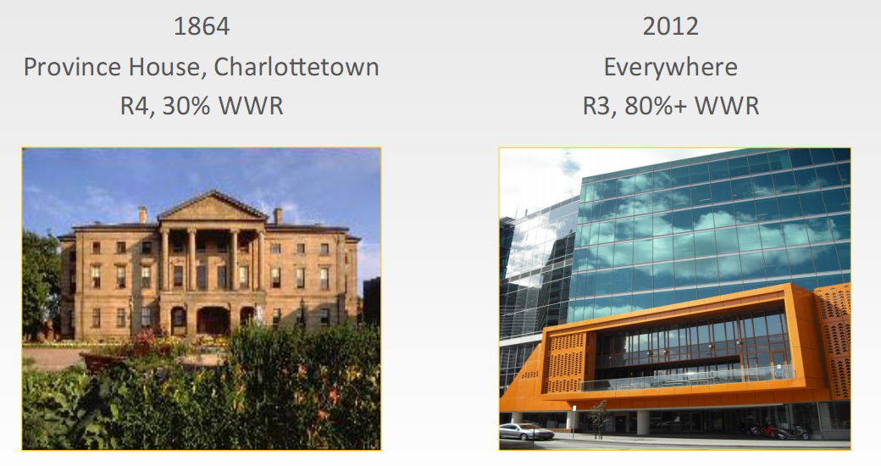
A Brief History Lesson
Why?
© Enermodal
Notes:
Equivalent KWh
Suzuki study says in the last 50 years we have shifted from a density of 4ppl/1000sf to 2ppl/2000sf
Best spandrel for these glass boxes is R14 and quite expensive whereas a regular wall is R20

Slide 31
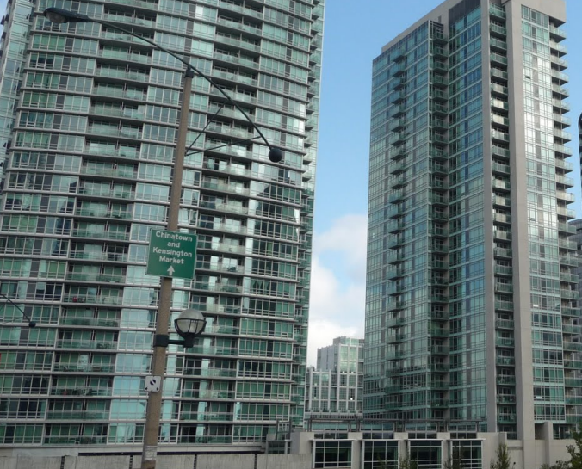
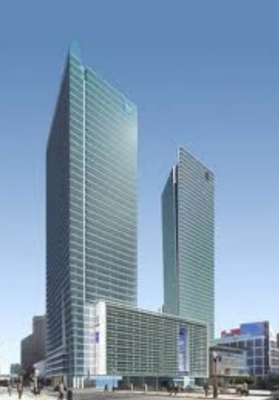
More Sustainable?

Slide 32
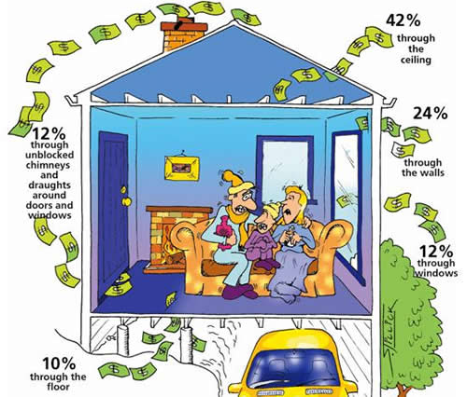
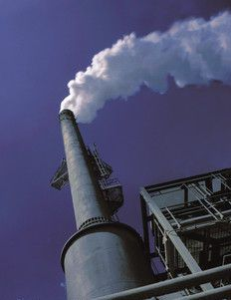
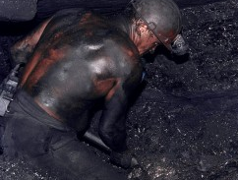
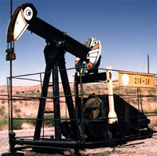
SOURCE
USE
3 Times as costly to Produce instead of Reduce
[12]
Notes:
IT’S THE ENERGY PRODUCTION THAT causes all of this. Due to 2 things, where we get our electricity and how we use it.
It is 3 times as costly to create 1 KWh of energy than it is to reduce the need for 1 KWh of energy. Thus it is more sensible to focus on decreasing our demand and rate of consumption.
Usage is an issue we can deal with rather than sourcing MORE

Slide 33
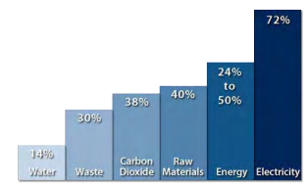
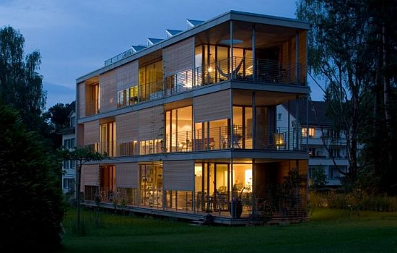
THE BUILT ENVIRONMENT
BUILDING CONSUMPTION | GREEN BUILDING CONSUMPTION
 | 13% lower maintenance costs 26% less energy usage 27% higher levels of occupant satisfaction 33% lower carbon dioxide (CO2) emissions
[6]

Slide 34
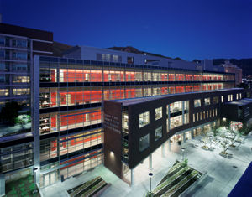
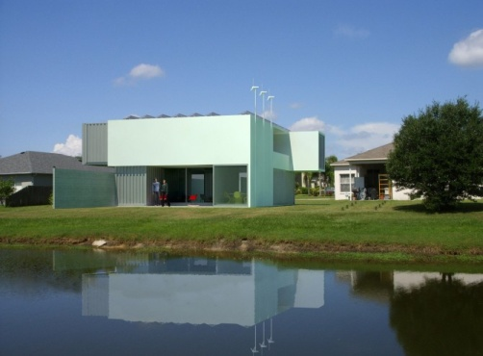
How to Reduce Those Levels?
WE USE ENGINEERING TOOLS:
Life Cycle Approach
Holistic Design Approach
Systems Thinking Approach
The Triple Bottom Line

Slide 35
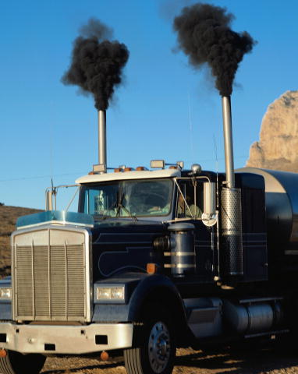
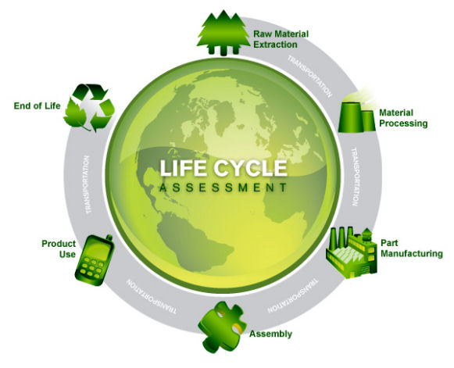
SUSTAINABILITY TOOLS
Life Cycle Assessment (LCA)
Extraction/Acquisition →Manufacturing → Transportation → Use → Disposal
[8]

Slide 36
Holistic Design Approach
The project is does not end after construction
Charrette helps define the project in its entirety
Integrated
Collaborative
[6]

Slide 37
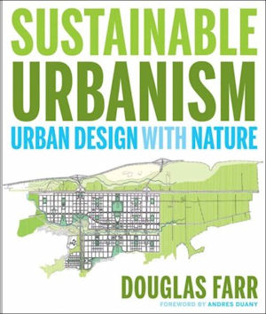
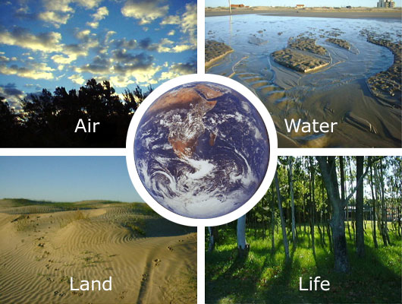
System Design Approach
Open System
Cradle to Grave
Self-destructive
Closed System
Cradle to Cradle
Sustainable
[6]

Slide 38
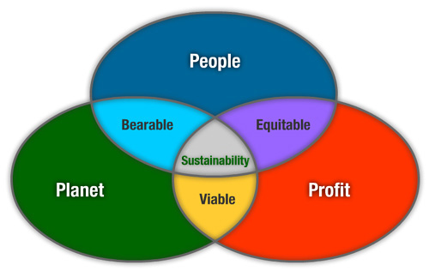
THE TRIPLE BOTTOM LINE
[6]

Slide 39
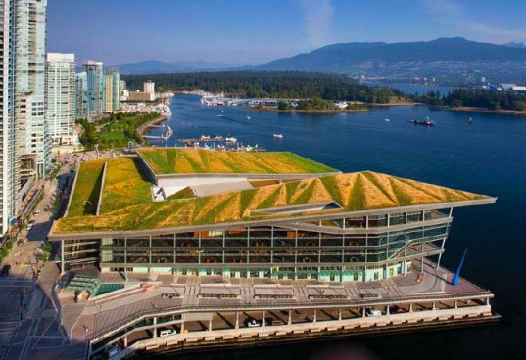
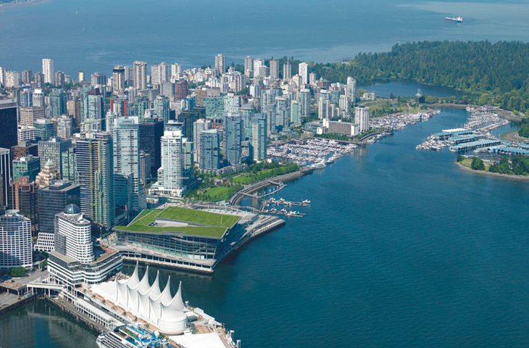
TODAY`S SOLUTION
Leadership in Energy and Environmental Design (LEED)
LEED is a Realistic First Step For Society
Green (Sustainable) Rating System
Systematically Incorporates all Engineering Tools
LEED Incorporates Smaller Scale Existing Standards
Legitimate - Created by Professionals for Professionals
First Quantifiable Third Party Green Assessment

Slide 40
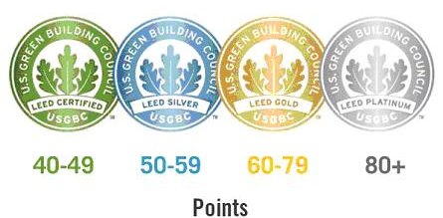
LEED Overview – THE RATING SYSTEMS
100 possible points + 6 Innovation Design +
4 Regional Priority = 110 TOTAL
5 Sustainable Categories to earn points
[9]

Slide 41
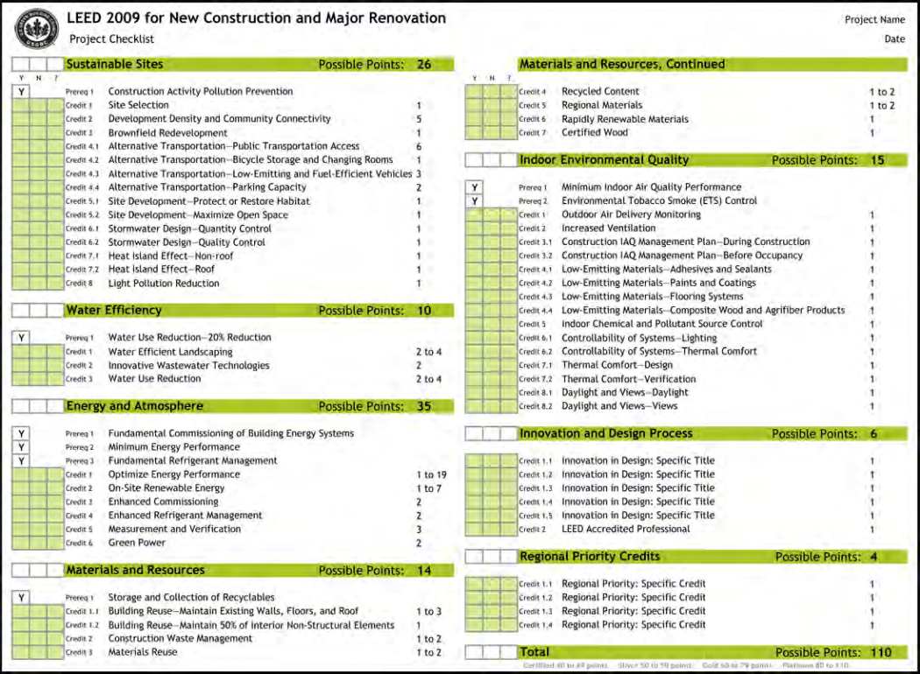
How LEED Works
Categories
Prerequisites - mandatory
Credits - optional
Award
[9]

Slide 42
Sustainable Sites
Water Efficiency
Energy & Atmosphere
Materials and Resources
Indoor Environmental Quality

Slide 43
LEED FOR THE DEVELOPER
Low Initial Cost ~ 1%
Green Does not mean Money
High Return on Investment
Marketability

Slide 44
LEED FOR THE DEVELOPER
Higher in the north due to Heating Load
[5]

Slide 45
[5]

Slide 46
LEED FOR THE DEVELOPER

Slide 47
LEED FOR THE CONSUMER
Supply and Demand
Generation X → Baby Boom Echo
Education Implementation → Increased Awareness
Cultural Change
Garbage Limit
Earth Day
New job market
It is our Future

Slide 48
LEED FOR THE CONSUMER

Slide 49
LEED BY THE GOVERNMENT
Lead by example
Government Incentives
The State as an example
Green roof by-law
Toilet Rebate
Adoption of Municipal Standards (Ex. PlaNYC)
Land is more valuable in cities
[14]

Slide 50
Living Building Challenge and BREEAM

Slide 51
RECAP – 7 Things to take away
LEARN FROM OUR PAST
Possible, its been done before
LEED IS A GREAT START WHICH IS ALWAYS EVOLVING
LEED VALUES MAKE SENSE
ALL STAKEHOLDERS MUST CONTRIBUTE
START NOW – WE HAVE DEVELOPED THE TOOLS
IT IS A COLLABORATIVE EFFORT

